Slide 1
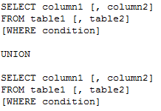
UNION:
The SQL UNION operator is used to combine the results of two or more SELECT statements without returning any duplicate rows.
Each SELECT statement within the UNION must have the same number of columns, the columns must have similar data types and the columns must be in the same order.
The basic syntax of UNION is -

Slide 2
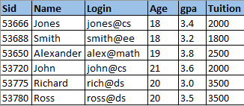
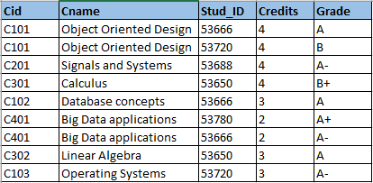
Let us consider our STUDENTS and COURSES table but with more rows added to COURSES.
STUDENTS COURSES
Let us consider an example to retrieve the name and age details of all students who took the course C101 or C401. We can perform this operation using the UNION keyword as shown below,

Slide 3
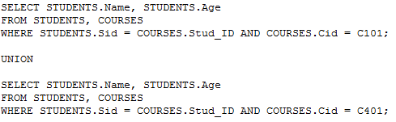

QUERY RESULT
Notice that each SELECT statement has same number of columns in the same order with similar data types.
The first SELECT statement results in 2 rows of output(Jones and John) and second SELECT statement results in 2 rows(Ross and Jones).
UNION operator eliminates any duplicate rows and hence Jones is displayed only once in the resultant table.

Slide 4

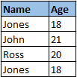
If you have noticed the example carefully, we can also formulate a query without using the UNION operator:
QUERY RESULT
Notice that Jones appears twice in the result since duplicate rows are not removed from the resultant table.
Let us consider another scenario where we have STUDENTS and TEACHERS tables with a common field (like “City”) present in both of them.

Slide 5
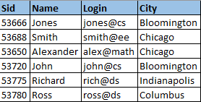
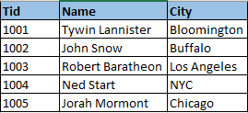
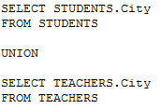

STUDENTS TEACHERS
Suppose we want to select all the different cities from STUDENTS and TEACHERS table. We can use UNION to achieve the results:
QUERY RESULT

Slide 6
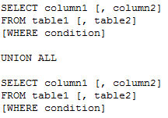
UNION ALL:
The SQL UNION ALL operator is used to combine the results of two or more SELECT statements including any duplicate rows.
UNION ALL works exactly the same way as UNION except that it does not eliminate duplicate records from the resultant table.
The basic syntax of UNION ALL is:
Let us consider the same example queries used for UNION and we can notice that duplicate rows are not removed from the resultant table.

Slide 7
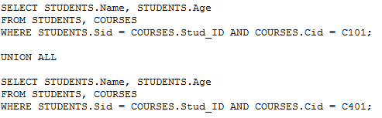

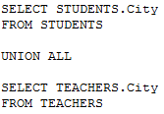
QUERY RESULT
QUERY RESULT

Slide 8
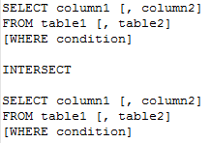
INTERSECT:
The SQL INTERSECT operator is used to combine two SELECT statements, but returns only such rows that are identical to both SELECT statements.
Just as with the UNION operator, the same rules apply when using the INTERSECT operator.
INTERSECT eliminates any duplicate records present in the result.
The basic syntax of INTERSECT is:

Slide 9
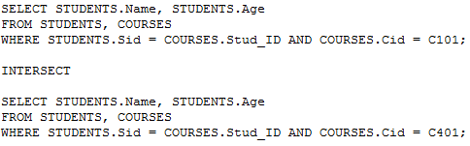

Let us consider our STUDENTS and COURSES table and try to retrieve the name and age details of all students who enrolled for both C101 and C401 courses.
This can be achieved using the INTERSECT operator as shown below -
QUERY RESULT
The first SELECT statement results in 2 rows(Jones and John) and second SELECT statement results in 2 rows(Ross and Jones). Since INTERSECT selects only the rows common to both the statements, we get Jones as the output. And he is indeed the only student who took both C101 and C401.

Slide 10
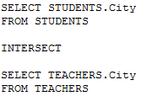

Let us consider another scenario where we have STUDENTS and TEACHERS tables and try to retrieve the cities that are common to both students and teachers.
This can be achieved using the INTERSECT operator as shown below -
QUERY RESULT
The first SELECT statement results in 6 rows of output and second SELECT statement results in 5 rows. Since only Bloomington and Chicago are common cities between these two tables, they are displayed in the resultant table, eliminating duplicate records.

Slide 11
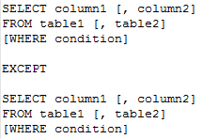
EXCEPT:
The SQL EXCEPT operator is used to combine two SELECT statements and returns rows from the first SELECT statement that are not returned by the second SELECT statement.
So EXCEPT returns only such rows, which are not available in second SELECT statement.
Just as with the UNION operator, the same rules apply when using the EXCEPT operator.
EXCEPT eliminates any duplicate records present in the result.
The basic syntax of EXCEPT is:

Slide 12
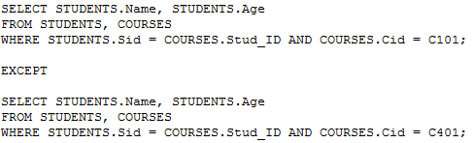

Let us consider our STUDENTS and COURSES table and try to retrieve the name and age details of all students who enrolled for course C101 but not C401.
QUERY RESULT
The first SELECT statement results in 2 rows of output(Jones and John) and second SELECT statement results in 2 rows(Ross and Jones).
EXCEPT returns rows from the first table that are not in second table, hence John is the output. And he is indeed enrolled for C101 but not for C401 whereas Jones enrolled for both C101 and C401.

Slide 13
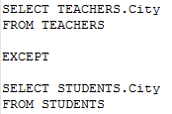

Let us consider another scenario where we have STUDENTS and TEACHERS tables and try to retrieve the cities of teachers that are different from cities of students.
This can be achieved using EXCEPT operator as shown below:
QUERY RESULT
We know that Bloomington and Chicago are the cities common to both tables and the cities of teachers different from cities of students are Buffalo, LA and NYC, as displayed by the above EXCEPT query.

